Slide 1

Join Data with

Slide 2
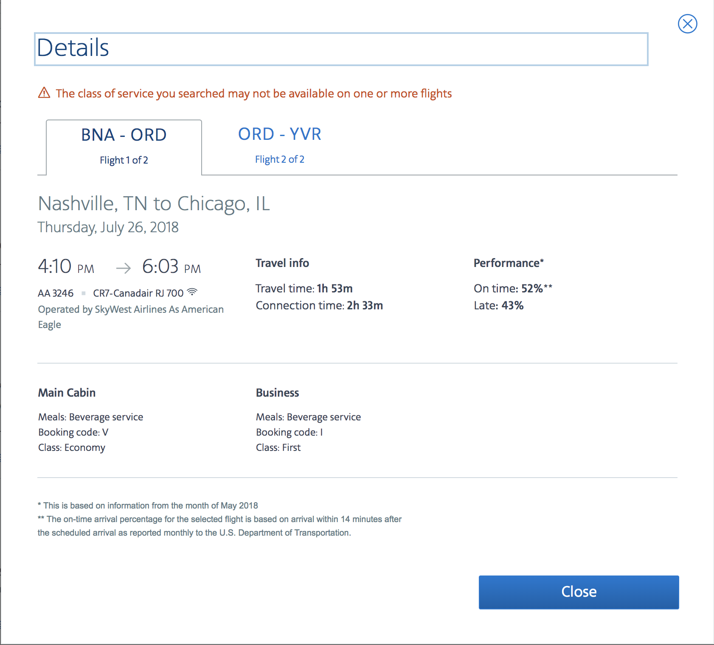

Slide 3
nycflights13
Data about every flight that departed La Guardia, JFK, or Newark airports in 2013
❒
# install.packages("nycflights13")
library(nycflights13)

Slide 4

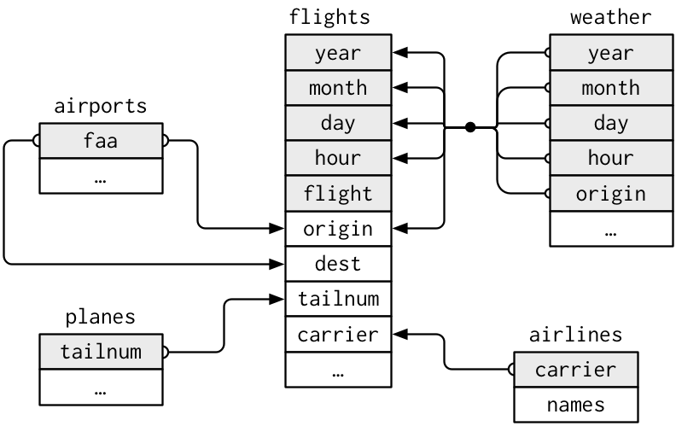
nycflights13
year
…

Slide 5
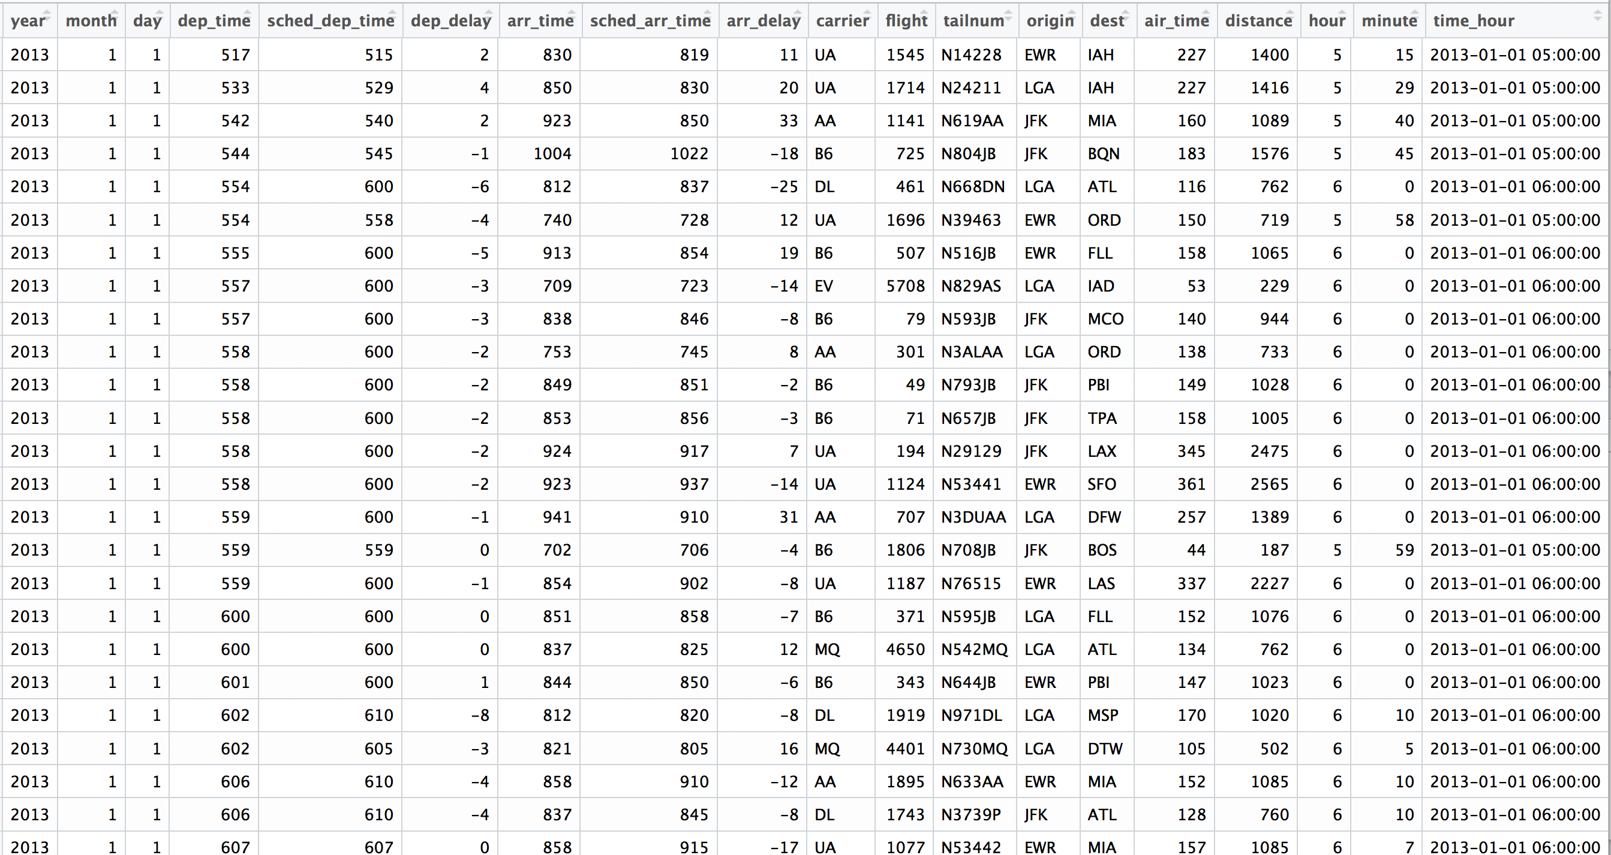
Flights
View(flights)

Slide 6
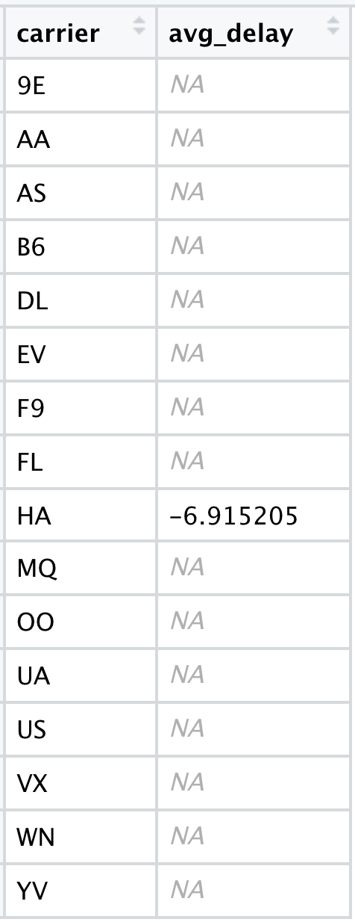
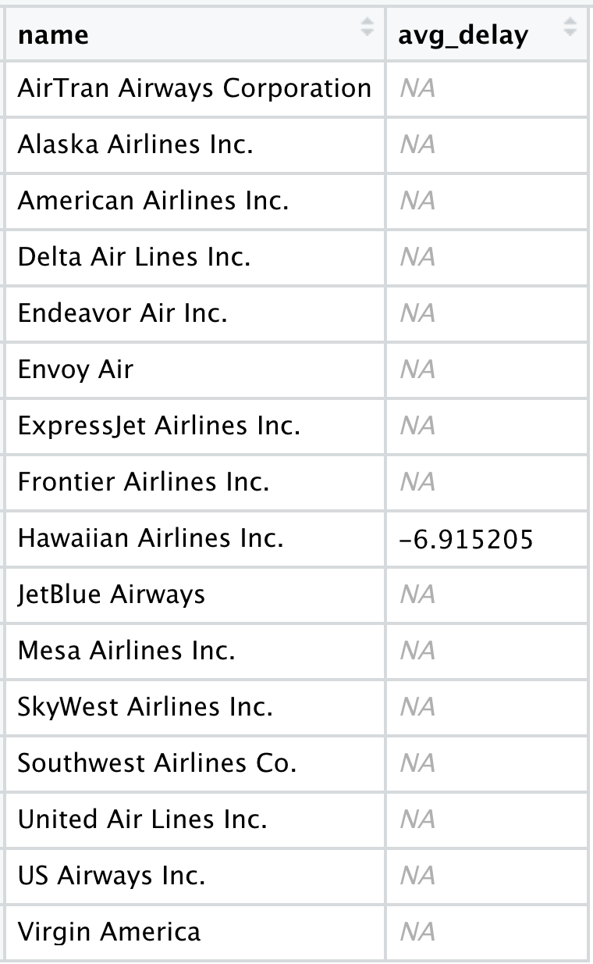
Flights
What airlines have the longest delays?
?
?
?
?
?
?
?
?
?
?
?
?
?
?
?
?

Slide 7


airlines
flights
?
?
?
?
?
?
?
?
?
?
?
?
?
?
?
?

Slide 8
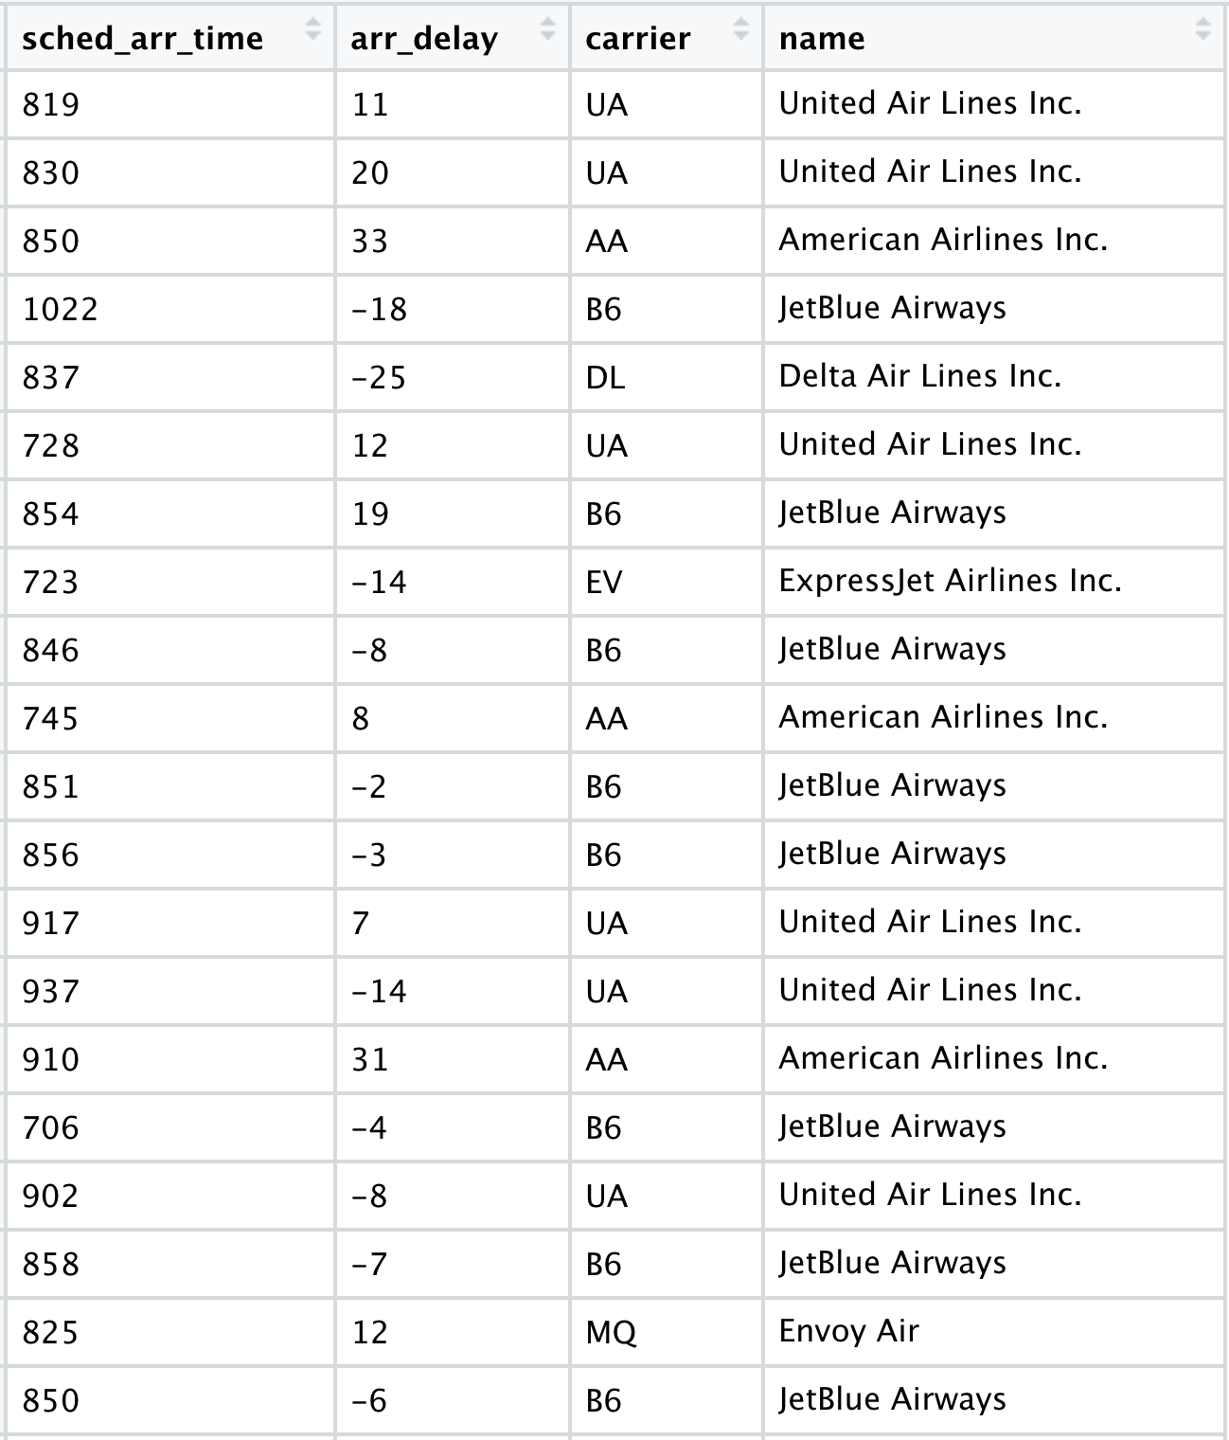
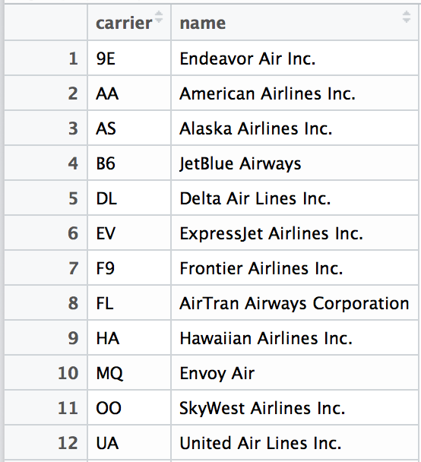
Airline names
View(flights)
View(airlines)

Slide 9
Airline names
View(flights)

Slide 10
Airline names
View(flights)

Slide 11
mutating joins

Slide 12
common syntax
Each join function returns a data frame / tibble.
left_join(x, y, by = NULL, … )
join function
data frames to join
names of columns to join on

Slide 13
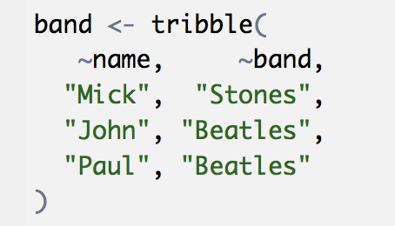
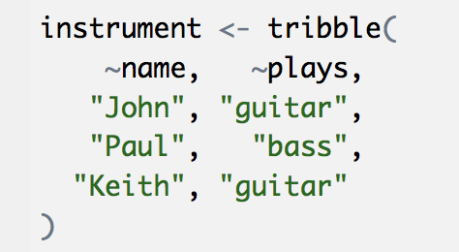
Toy data
band
name | band
Mick | Stones
John | Beatles
Paul | Beatles
instrument
instrument2 <- tribble(
~artist, ~plays,
"John", "guitar",
"Paul", "bass",
"Keith", "guitar"
)
name | plays
John | guitar
Paul | bass
Keith | guitar

Slide 14
Toy data
band
instrument
name | band
Mick | Stones
John | Beatles
Paul | Beatles
name | plays
John | guitar
Paul | bass
Keith | guitar

Slide 15
The pipe operator %>%
%>%
instrument %>% left_join( , by = "name")
Passes result on left into first argument of function on right.
So, for example, these do the same thing. Try it.
left_join(instrument, by = "name")
instrument %>% left_join(by = "name")

Slide 16
left
band %>% left_join(instrument, by = "name")
band
instrument
name | band
Mick | Stones
John | Beatles
Paul | Beatles
name | plays
John | guitar
Paul | bass
Keith | guitar
name | band | plays
Mick | Stones | <NA>
John | Beatles | guitar
Paul | Beatles | bass
+
=

Slide 17
left
band %>% left_join(instrument, by = "name")
band
instrument
name | band
Mick | Stones
John | Beatles
Paul | Beatles
name | plays
John | guitar
Paul | bass
Keith | guitar
name | band | plays
Mick | Stones | <NA>
John | Beatles | guitar
Paul | Beatles | bass
+
=

Slide 18
right
band %>% right_join(instrument, by = "name")
band
instrument
name | band
Mick | Stones
John | Beatles
Paul | Beatles
name | plays
John | guitar
Paul | bass
Keith | guitar
name | band | plays
John | Beatles | guitar
Paul | Beatles | bass
Keith | <NA> | guitar
+
=

Slide 19
full
band %>% full_join(instrument, by = "name")
band
instrument
name | band
Mick | Stones
John | Beatles
Paul | Beatles
name | plays
John | guitar
Paul | bass
Keith | guitar
name | band | plays
Mick | Stones | <NA>
John | Beatles | guitar
Paul | Beatles | bass
Keith | <NA> | guitar
+
=

Slide 20
inner
band %>% inner_join(instrument, by = "name")
band
instrument
name | band
Mick | Stones
John | Beatles
Paul | Beatles
name | plays
John | guitar
Paul | bass
Keith | guitar
name | band | plays
John | Beatles | guitar
Paul | Beatles | bass
+
=

Slide 21
Airline names
View(flights)
View(airlines)

Slide 22
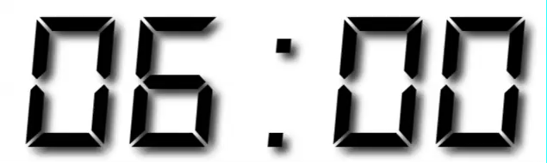
Your Turn 1
Which airlines had the largest arrival delays? Work in groups to complete the code below.
flights %>%
filter(!is.na(arr_delay)) %>%
%>%
group_by( ) %>%
%>%
arrange( )
1. Join airlines to flights
2. Compute and order the average arrival delays by airline. Display full names, no codes.

Slide 23
flights %>%
filter(!is.na(arr_delay)) %>%
left_join(airlines, by = "carrier") %>%
group_by(name) %>%
summarise(delay = mean(arr_delay)) %>%
arrange(delay)
## # A tibble: 16 × 2
## name delay
## <chr> <dbl>
## 1 Alaska Airlines Inc. -9.9308886
## 2 Hawaiian Airlines Inc. -6.9152047
## 3 American Airlines Inc. 0.3642909
## 4 Delta Air Lines Inc. 1.6443409
## 5 Virgin America 1.7644644

Slide 24
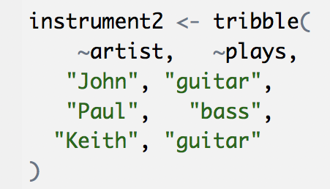
Toy data
band
name | band
Mick | Stones
John | Beatles
Paul | Beatles
instrument2
artist | plays
John | guitar
Paul | bass
Keith | guitar

Slide 25
What if the names do not match?
Use a named vector to match on variables with different names.
band %>% left_join(instrument2, by = c("name" = "artist"))
The name of the element = the column name in the first data set
The value of the element = the column name in the second data set
A named vector

Slide 26
What if the names do not match?
Use a named vector to match on variables with different names.
band %>% left_join(instrument2, by = c("name" = "artist"))
band
instrument2
name | band
Mick | Stones
John | Beatles
Paul | Beatles
artist | plays
John | guitar
Paul | bass
Keith | guitar
name | band | plays
Mick | Stones | <NA>
John | Beatles | guitar
Paul | Beatles | bass
+
=

Slide 27
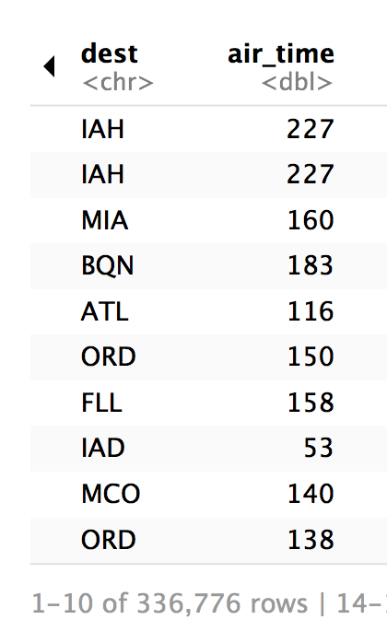
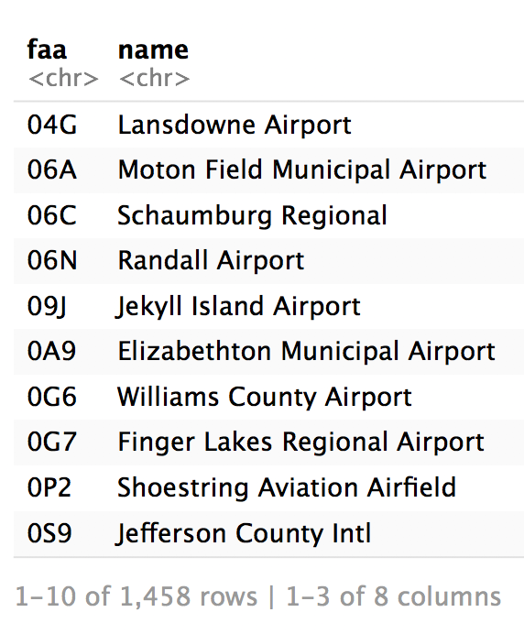
Airport names
flights %>% select(14:15)
airports %>% select(1:3)

Slide 28
common syntax - matching names
flights %>% left_join(airports, by = c("dest" = "faa"))

Slide 29
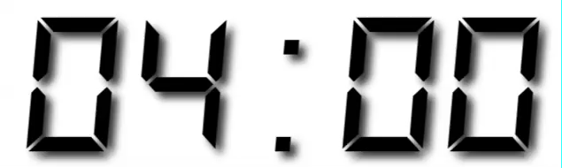
Your Turn 2
Join flights and airports by dest and faa.
Then for each name, compute the distance from NYC and the average arr_delay. Hint: use first() to get the first value of distance.
Order by average delay, worst to best.

Slide 30
flights %>%
filter(!is.na(arr_delay)) %>%
left_join(airports, by = c("dest" = "faa")) %>%
group_by(name) %>%
summarise(distance = first(distance),
delay = mean(arr_delay)) %>%
arrange(desc(delay))
## # A tibble: 101 × 3
## name distance delay
## <chr> <dbl> <dbl>
## 1 Columbia Metropolitan 602 41.76415
## 2 Tulsa Intl 1215 33.65986
## 3 Will Rogers World 1325 30.61905

Slide 31
filtering joins

Slide 32
filtering joins
Mutating joins use information from one data set to add variables to another data set (like mutate())
Filtering joins use information from one data set to extract cases from another data set (like filter())

Slide 33
semi
band %>% semi_join(instrument, by = "name")
band
instrument
name | band
Mick | Stones
John | Beatles
Paul | Beatles
name | plays
John | guitar
Paul | bass
Keith | guitar
name | band
John | Beatles
Paul | Beatles
+
=

Slide 34
anti
band %>% anti_join(instrument, by = "name")
band
instrument
name | band
Mick | Stones
John | Beatles
Paul | Beatles
name | plays
John | guitar
Paul | bass
Keith | guitar
name | band
Mick | Stones
+
=

Slide 35
Airport names
airports %>% select(1:3)
flights %>% select(14:15)

Slide 36
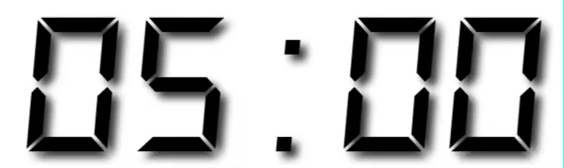
Your Turn 3
How many airports in airports are serviced by flights in flights? (i.e. how many places can you fly to direct from New York?)
Notice that the column to filter on is named faa in the airports dataset and dest in the flights dataset.

Slide 37
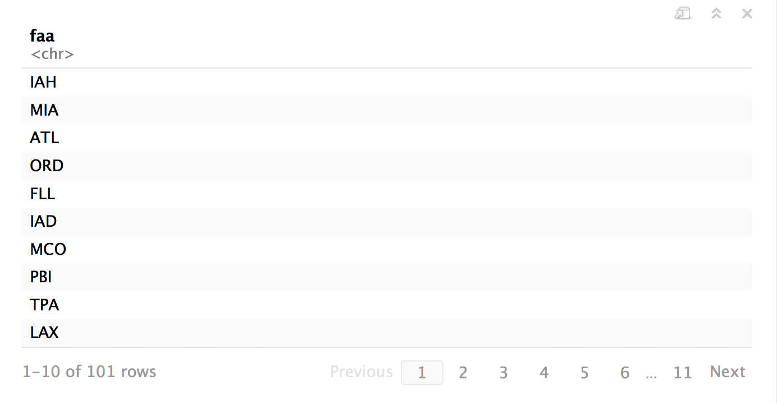
airports %>%
semi_join(flights, by = c("faa" = "dest")) %>%
select(faa)

Slide 38
distinct()
Removes rows with duplicate values (in a column).
distinct(df, name)
df
name | band
Mick | Stones
John | Beatles
John | Zeppelin
name
Mick
John

Slide 39
distinct()
Removes rows with duplicate values (in a column).
distinct(instrument, plays)
instrument
name | plays
John | guitar
Paul | bass
Keith | guitar
plays
guitar
bass

Slide 40
Recap: Two table verbs
+
=
left_join() retains all cases in left data set
right_join() retains all cases in right data set
full_join() retains all cases in either data set
inner_join() retains only cases in both data sets
semi_join() extracts cases that have a match
anti_join() extracts cases that do not have a match
name | band
Mick | Stones
John | Beatles
Paul | Beatles
name | plays
John | guitar
Paul | bass
Keith | guitar
name | band | plays
Mick | Stones | <NA>
John | Beatles | guitar
Paul | Beatles | bass
+
=
name | band
Keith | guitar
John | Beatles
Paul | Beatles
name | plays
John | guitar
Paul | bass
Paul | bass
plays | band | plays
guitar | Stones | guitar
guitar | Beatles | guitar
bass | <NA> | bass
+
=
name | band
John | Beatles
John | Beatles
Paul | Beatles
name | plays
John | guitar
Paul | bass
Paul | bass
band | band | plays
Stones | Stones | <NA>
Beatles | Beatles | guitar
Beatles | Beatles | bass
 | <NA>
+
=
name | band
Keith | guitar
John | Beatles
Paul | Beatles
name | plays
John | guitar
Paul | bass
Keith | guitar
name | band | plays
Mick | Stones | guitar
John | Beatles | guitar
<NA> | <NA> | <NA>
+
=
name | band
Keith | guitar
John | Beatles
Paul | Beatles
name | plays
John | guitar
Paul | bass
Keith | guitar
name | band | <NA>
Mick | Stones | <NA>
John | Beatles | <NA>
<NA> | <NA> | <NA>
+
=
name | band
Keith | guitar
John | Beatles
Paul | Beatles
name | plays
John | guitar
Paul | bass
Keith | guitar
name | band | <NA>
<NA> | <NA> | <NA>
<NA> | <NA> | <NA>
<NA> | <NA> | <NA>

Slide 41
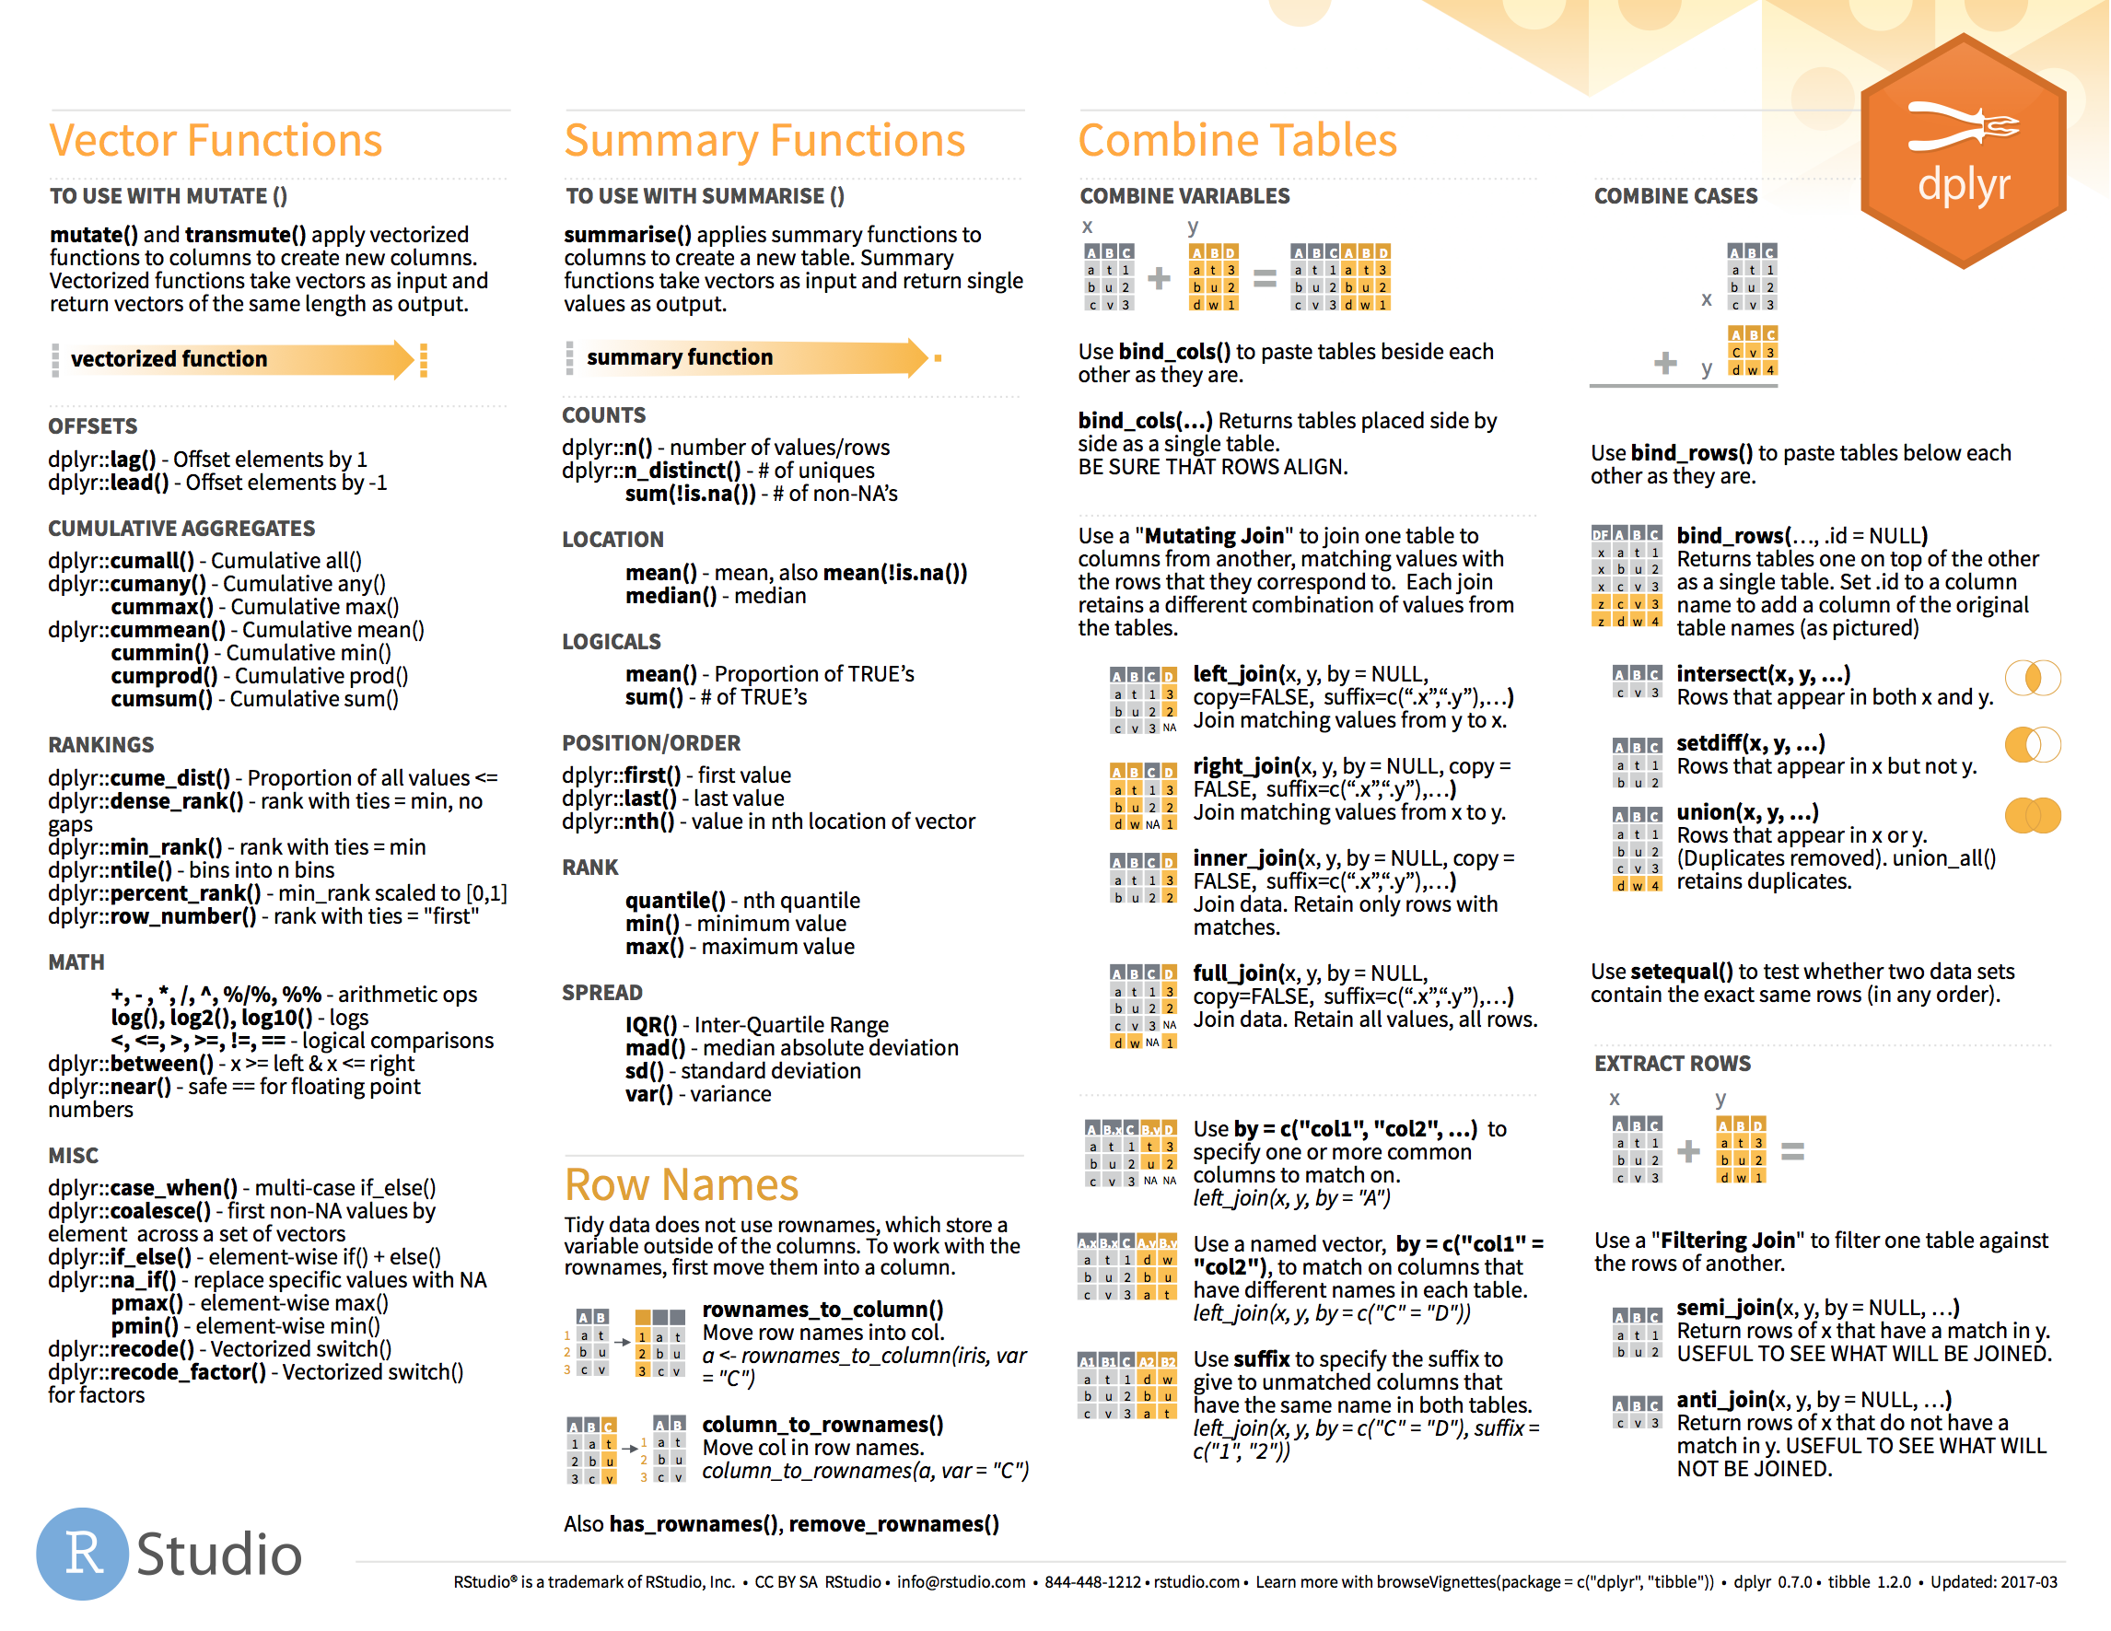
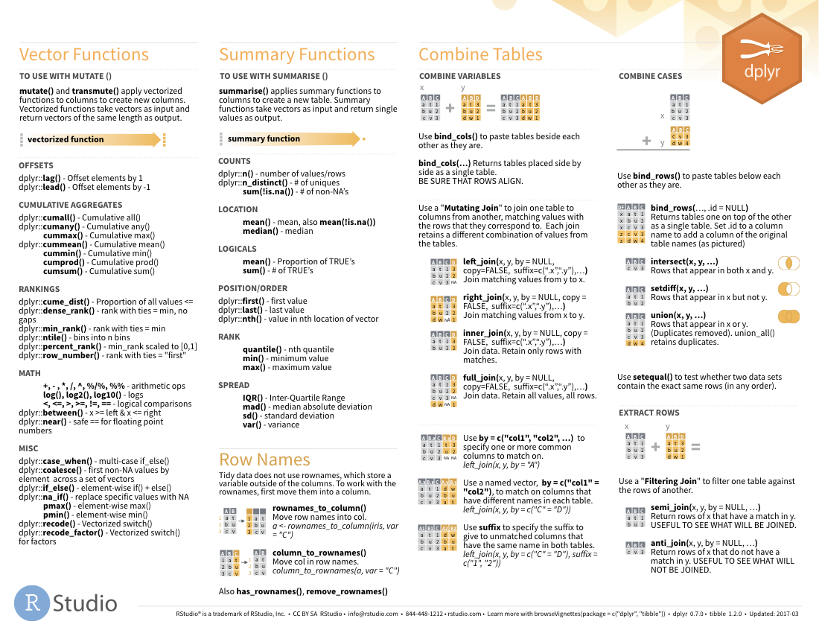

Two table verbs
Data Transformation cheatsheet
on back

Slide 42

Databases

Slide 43
Join Data with

